Slide 1


Anime Face GAN Project
DIGCRE HS21
Filip Krsmanovic

Slide 2
Project idea:
First Idea -> Generating whole Anime-Characters
Bailed because training time would take too long for good results...
Second Idea and taken -> Anime Faces
Whole process from preparing dataset to actual training

Slide 3
From Zero to Anime Face
Finding a huge amount of images...
Torrented 33 GB of pictures from www.gwern.net (300k images)

Slide 4
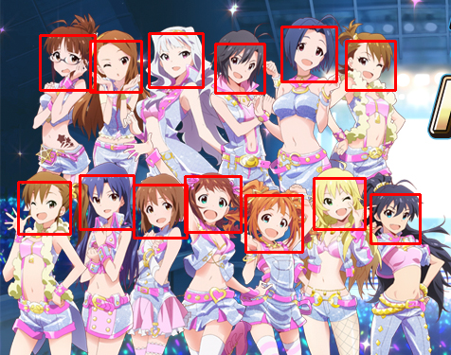
From Zero to Anime Face
Preparing the Dataset
Step 1: Detecting the Faces from the image with OpenCV detector

Slide 5
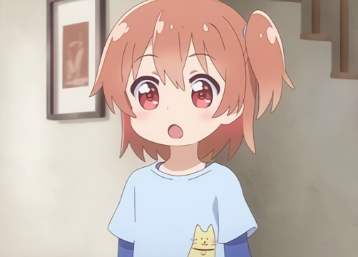
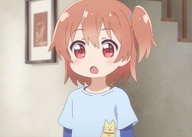
From Zero to Anime Face
Preparing the Dataset
Step 2: Upscaling the images with waifu2xx ncnn Vulkan

Slide 6
From Zero to Anime Face
Preparing the Dataset
Step 3: Getting all images to 512x512 with Microsoft PowerToys

Slide 7
From Zero to Anime Face
Training
Step 1: Finding a .pkl model
Step 2: Setting up the colab notebook
Step 3: Actual training (47.5 hours)

Slide 8
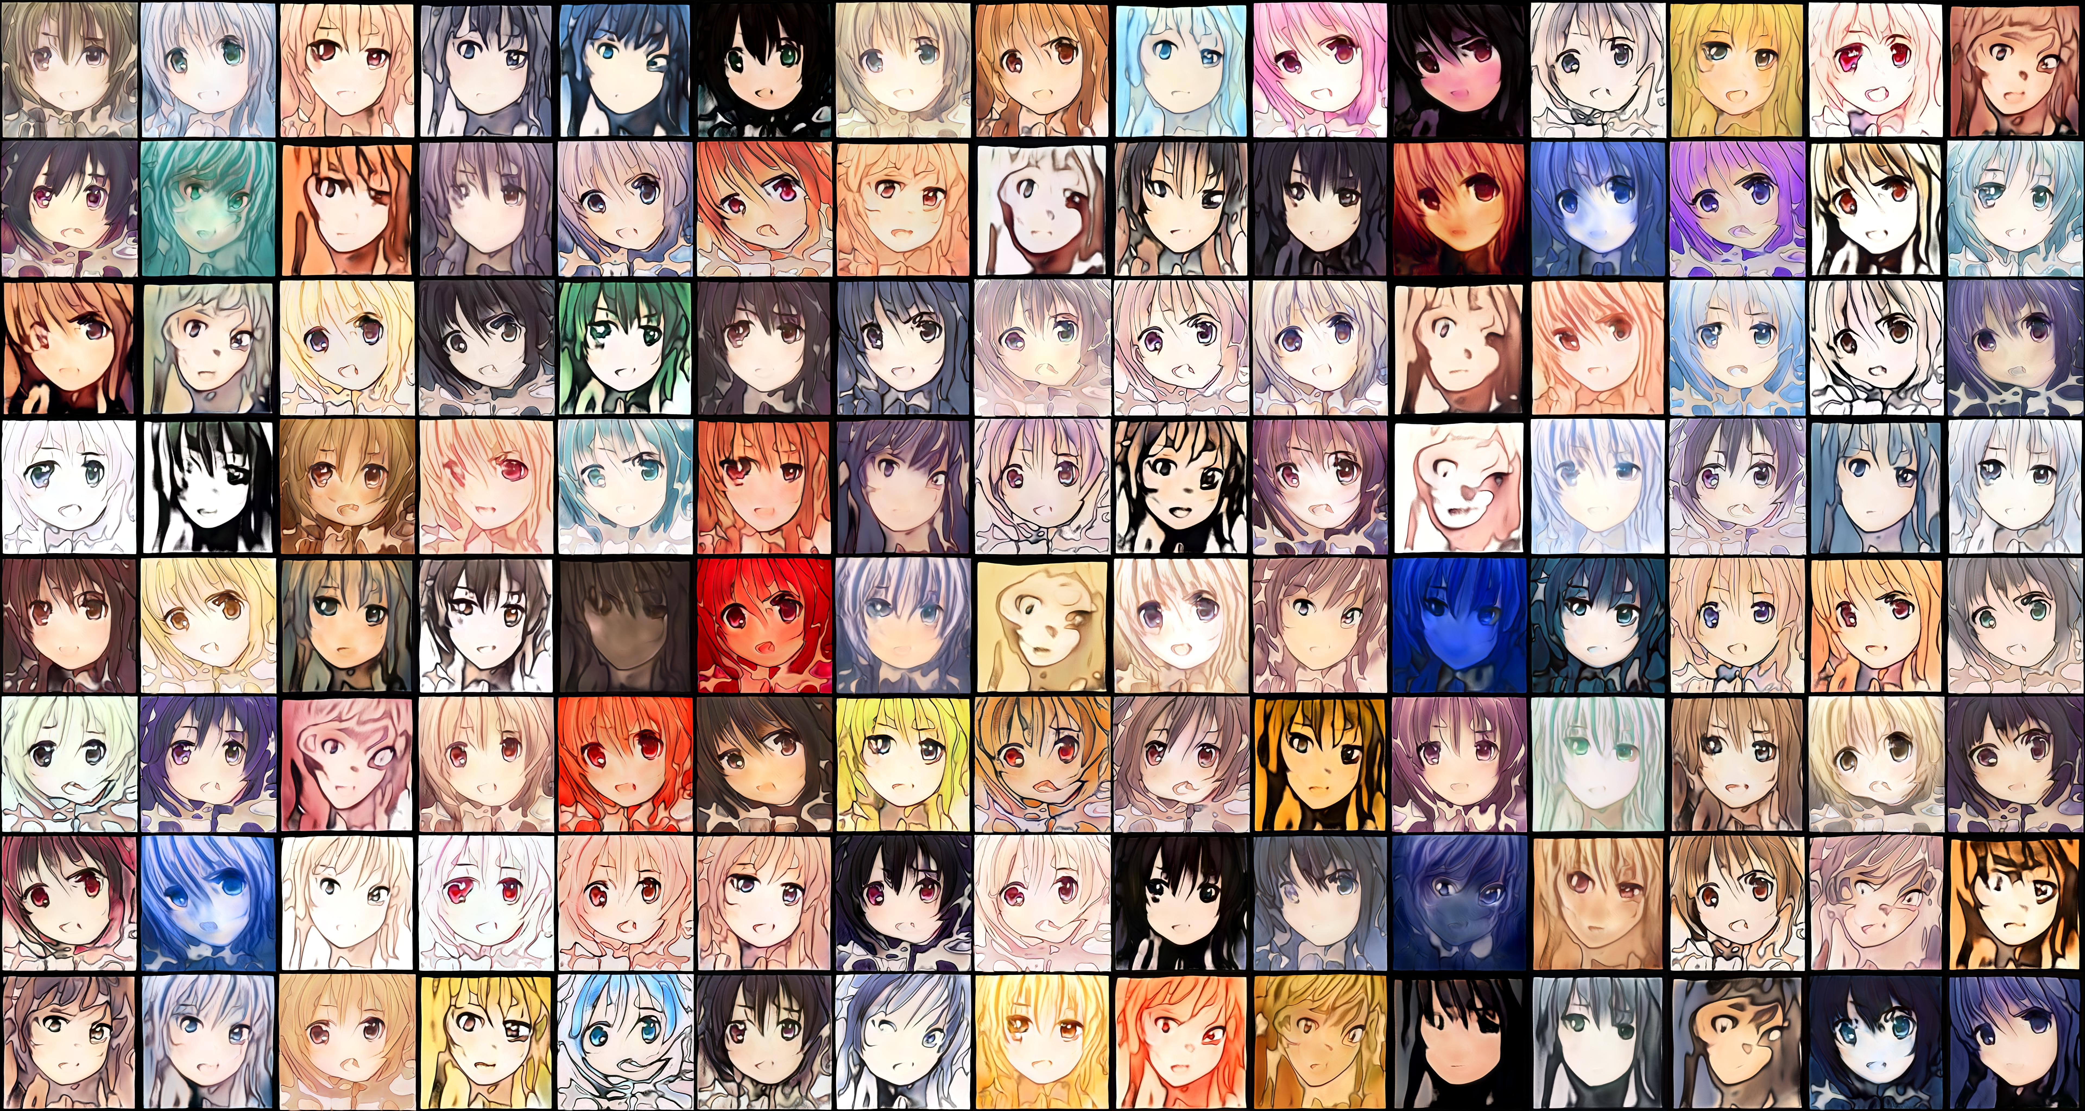
Results

Slide 9
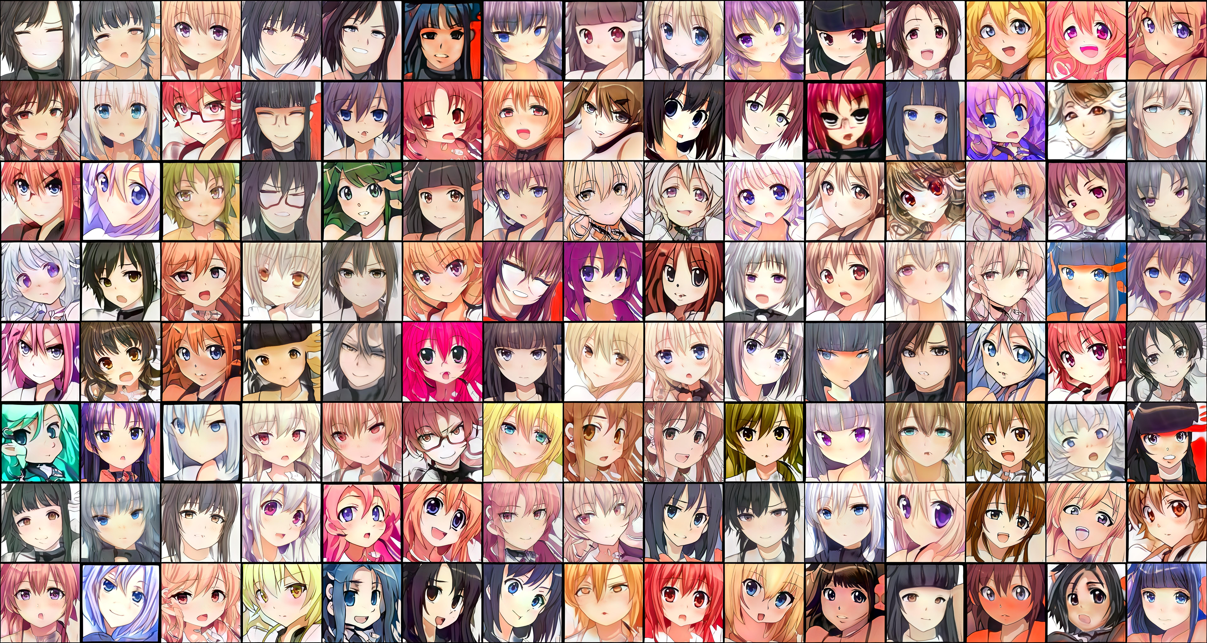
Results

Slide 10

Linear Interpolation with 7 seeds

Slide 11
Difficulties
Dataset size during training
Crashes
Deploying the model

Slide 12
Github Repo

